Slide 1


ABMSP’S ANANTRAO PAWAR COLLEGE OF ENGINEERING
Parvati , pune-28
Topic Name:- AUTOMATED PARALYSIS PATIENT HEALTHCARE MONITORING SYSTEM
Presented By:-
*Manthan Jadhav
*Aniket Zanje
*Pavan Jadhav
*Vishnu Rathod
-Project Guide:- Prof. A.N. Kalal

Slide 2
CONTENTS
INTRODUCTION
PROBLEM STATEMENT / TITLE BASED ON LITERATURE SURVEY
GOALS AND OBJECTIVES
LITERATURE SURVEY
REQUIRED HARDWARE, SOFTWARE
SYSTEM OVERVIEW- Proposed System and outcomes
PROPOSED SYSTEM ARCHITECTURE
DFD Level 0-1
USE CASE DIAGRAM
SEQUENCE DIAGRAM

Slide 3
CLASS DIAGRAM
STATE DIAGRAM
IMPLEMENTATION
CONCLUSION
REFERENCE

Slide 4
INTRODUCTION
In real world, there are many people who are paralytic and cannot communicate easily.
Motions can be used to communicate words and sentence to audience.
The work of this project is to provide aid to such people with the help of motions and sensors For communication of paralytic people
It is portable and very easy to handle. In this project angle sensor are used to convert physical parameter into electrical signal
The main cause of death in many countries over 15 million deaths in word wide under there is no proper take care of the patient
So this system actual help to what’s want to the paralysis patient.

Slide 5
PROBLEM STATEMENT
In today’s social Health Insurance structure where patients stay at home after Operations they are not possible monitored 24-hours by a medical caretaker or a family member so. Many people now a days who work full time are facing a problem of monitoring especially old age patient’s. So to overcome this problem we are using this patient health monitoring system using IOT.

Slide 6
GOALS AND OBJECTIVES
Goals -
Where we see a problem with these types of devices that are being developed is that they are very large and expensive machines, They seem to be only available in hospitals and not able to be used at the patient’s home or at their convenience.
Our goal is to make a device that will be help the patient fully monitoring stay at home after operation and able to retrain a patient’s motion but have them be able.

Slide 7
Objectives -
Because of expanding work cost, medical institutions would constrain to decrease nursing staff for patients. Our project aims to develop new innovation for the use of basic nursing care. It helps us to take care of patient health care without nurse.
This system also takes care of the situation wherein no one is present to attend the patient and thus sending a message through GSM of what he wants to convey in SMS and also sound a speaker along with message.

Slide 8
PROBLEM STATEMENT / TITLE BASED ON LITERATURE SURVEY
Methodology, only there exists the technology of monitoring the patient heart rate in the nearby terminal display unit and the remote monitoring is enabled only when there exists the WIFI connectivity.
Proposed a smart phone based remote patient monitoring system. In this system, a smartphone application (app) is implemented. Patient can have a video conference with the doctor by using a smartphone to discuss the treatment process.
This paper presents the implementation of automated IoT based healthcare system for remotely located patients which helps doctors and guide them accordingly. The system provides alerts by the means of E-mails in case of abnormal conditions observed in the monitoring parameters of the patient.
The author in paper proposed the system that makes use of mobile phone’s inbuilt Bluetooth facility for automation without using Air Time. The author in paper have described different hardware and software units that make complete application software design for paralyzed patients.

Slide 9
LITERATURE SURVEY
AUTORE | PROJECT NAME | PUBLISHED
J S Sujin;S Mukesh;M J Praveen Raj;M Sashwanth;R Ramesh Kumar. (2021,march). | “IoT based Patient Monitoring System using TCP/IP Protocol.” | 7th International Conference on Advanced Computing and Communication Systems (ICACCS).
Zainab Pirani;Afiya Momin;Anood Kadri;Arafat Shaikh (2018,april). | “Survey of Numerous Accessible Applications for Paralysis Patients.” | Second International Conference on Intelligent Computing and Control Systems (ICICCS).
Hoe Tung Yew;Ming Fung Ng;Soh Zhi Ping;Seng Kheau Chung;Ali Chekima;Jamal A. Dargham (2020, july). | “IoT Based Real-Time Remote Patient Monitoring System.” | 16th IEEE International Colloquium on Signal Processing & Its Applications (CSPA).
Rani G. Utekar;Jayant S. Umale (2019, june). | “Automated IoT Based Healthcare System for Monitoring of Remotely Located Patients.” | Fourth International Conference on Computing Communication Control and Automation (ICCUBEA).
OBSERVATION
This process of continuously tracking the patient’s vital parameters suggested by the doctor. is designed to help the patient to convey their health issues/status.
In this system is availability, flexibility, high speed, reduce cost of wiring and simple use of technologies.
This paper proposes an IoT based real-time electrocardiogram (ECG) monitoring system that is able to support both real-time and store-and-forward modes.
In this paper the patient can using mobile phone automatically handle home hardware and software.

Slide 10
LIST OF REQUIRED HARDWARE , SOFTWARE
Software requirement
Operating System : Windows/Linux
Technology : Java and J2EE
IDE : My Eclipse, net bean
Database : My SQL
Java Version : 8 and above
Hardware Specification
System : Pentium IV 2 GHz
Hard Disk : 250 GB.
Ram : 3GB
Device : HRM device.
Sensors : Temperature, Flux
Modules : GSM, VOICE
Arduino
16*2 LCD Display

Slide 11
SYSTEM OVERVIEW
Proposed System -
Paralysis is the inability to move muscles on your own and with purpose. It can be
temporary or permanent. The most common causes are stroke, spinal cord injury, and multiple
sclerosis. Paralysis can be a complete loss of movement known as plebeian, or a significant
weakness called paresis. Even though, there are innovative approaches for curing or treating
paralysis patients, but the aim of treatment is to help a person adapt to life with paralysis by
making them as independent as possible. Where we see a problem with these types of devices
that are being developed is that they are very large and expensive machines. They seem to be
only available in hospitals and not able to be used at the patient’s home or at their convenience.
Our goal is to make a device that will be able to retrain a patient’s motion but have them be able
to use the device themselves and have it been cheap enough for them to afford without much debt.

Slide 12
Proposed Outcomes
➢ Easy to implement and manage
➢ Increased productivity
➢ Eliminates human error
➢ Reduces cost
➢ Improves patient care and satisfaction
➢ Increases security through audit trails
➢ Maintains regulatory compliance
➢ Easily integrates with existing systems

Slide 13
Architecture of Module

Slide 14
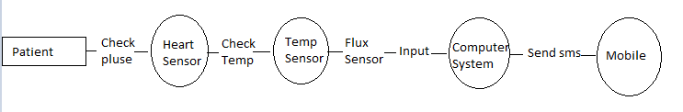
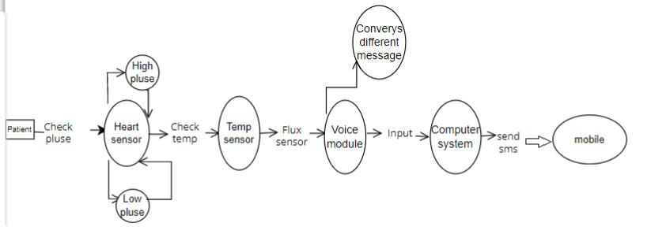
DFD Level 0
DFD Level 1

Slide 15
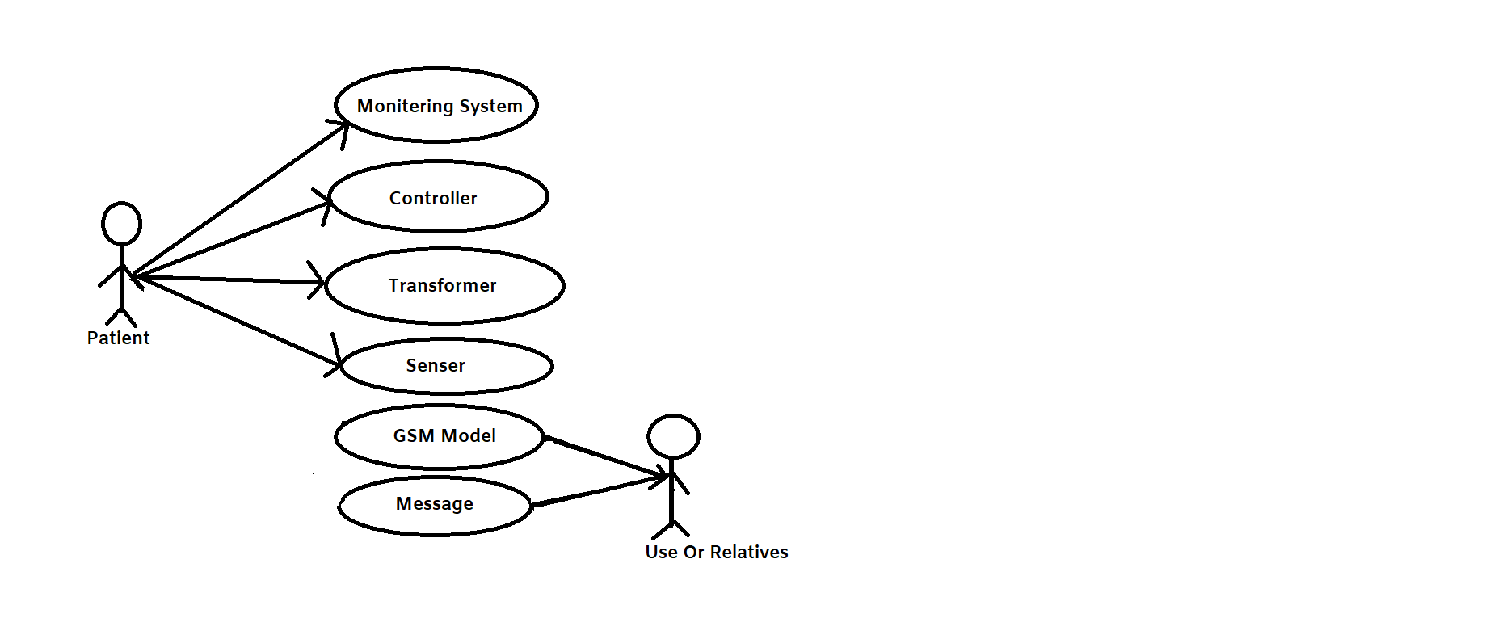
UML Diagram:- Use Case Diagram

Slide 16
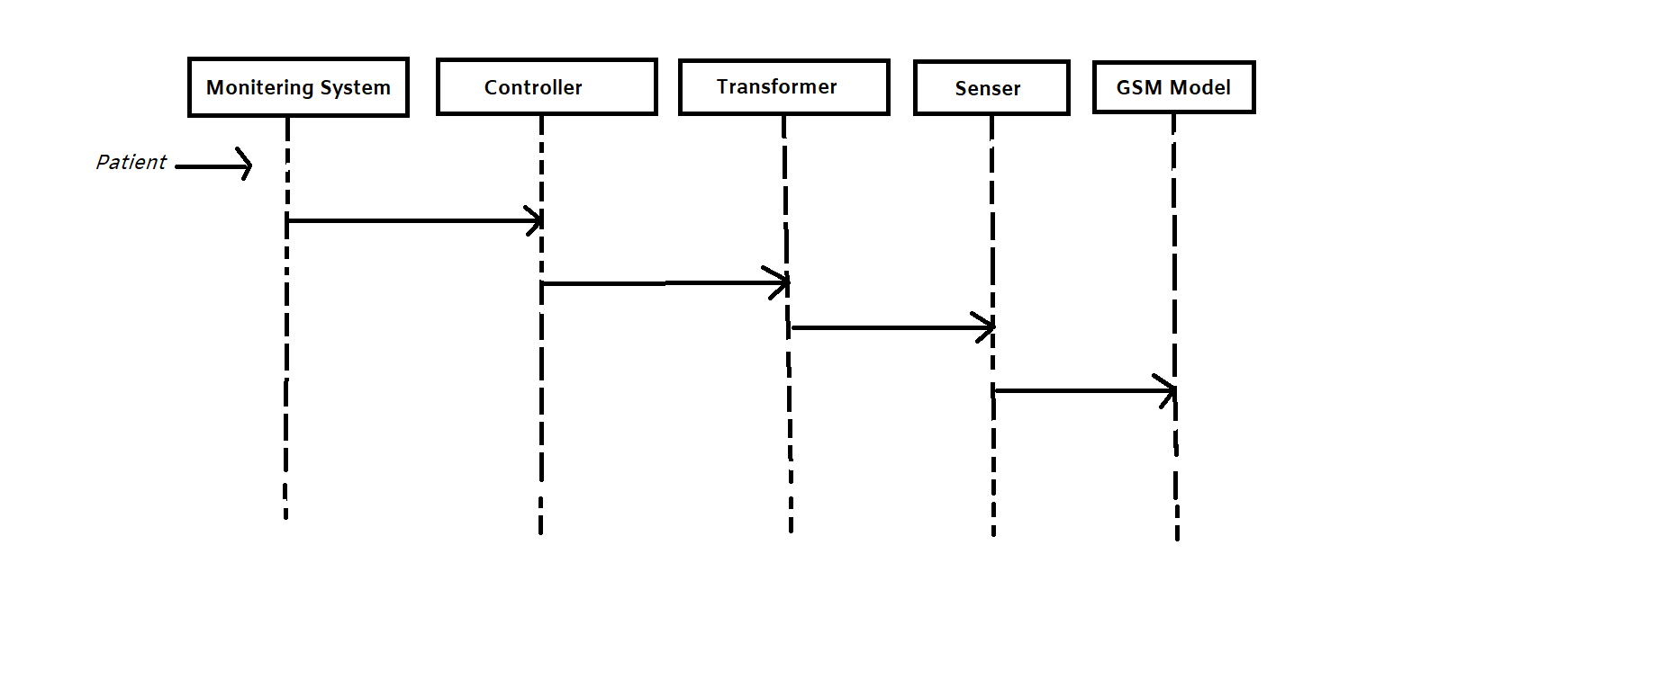
UML Diagram:- Sequence Diagram

Slide 17
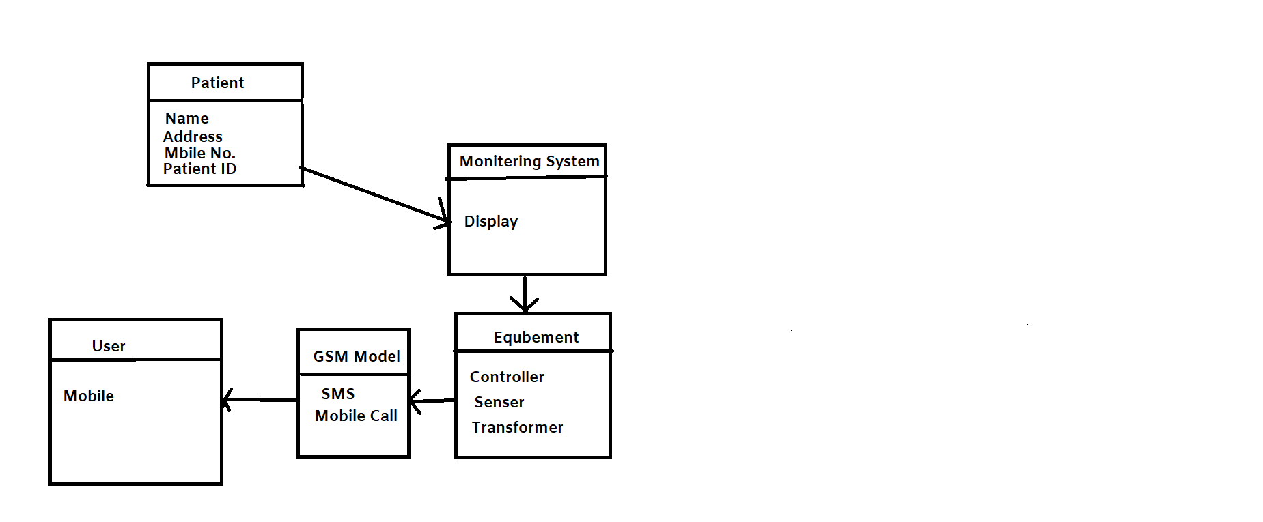
UML Diagram:- Class Diagram

Slide 18
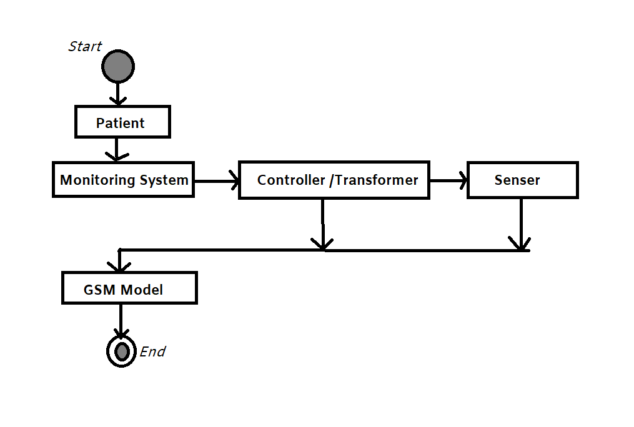
UML Diagram:- State Diagram

Slide 19
Implementation:
Tools and Technology used
Tools Used:
Python3 IDE
Spyder Python3
Visual Studio Code
Technology:
IoT:- IoT-based home automation project aims to automate the functioning of household appliances and objects over the Internet. All the household objects that are connected over the IoT network can be controlled and operated through your.
IoT is described as a network of connected physical objects with the help of the internet. Physical objects list includes software, embedded electronics, sensors, and many more. In simple terms, IoT is collecting and exchanging data among the network of connected devices to make a better decision.

Slide 20
Arduino :- Arduino Uno is the ideal board for getting started with electronics, through fun and engaging hands-on projects. This board is your entry to the unique Arduino experience: great for learning the basics of how sensors and actuators work, and an essential tool for your rapid prototyping needs. Arduino is an open-source platform used for building electronics projects. Arduino consists of both a physical programmable circuit board (often referred to as a microcontroller) and a piece of software, or IDE (Integrated Development Environment) that runs on your computer, used to write and upload computer code to the physical board.

Slide 21
CONCLUSION
All in all, this project achieved a lot of its goals. The project implemented a low cost, low power, LCD pulse rate display system using microcontroller technology. Lists of accomplishments include portability, reliability and analog to digital conversion and also the system is easily accessible.
Our system successfully proves that this system is an excellent approach to be implemented at hospitals for patient-nurse communication.
The ease of message conveyance is the main advantage of this system along with the real time user defined medicine alarm. By implementing this system, a simple device for paralyzed or disabled people can be achieved without the use of complex form of inputs.
can also be transmitted to the nurse so that a real time record of all the patients is maintained.

Slide 22
REFERENCES
J S Sujin;S Mukesh;M J Praveen Raj;M Sashwanth;R Ramesh Kumar. (2021,march) "IoT based Patient Monitoring System using TCP/IP Protocol". 7th International Conference on Advanced Computing and Communication Systems (ICACCS).
Zainab Pirani;Afiya Momin;Anood Kadri;Arafat Shaikh (2018,april) "Survey of Numerous Accessible Applications for Paralysis Patients". Second International Conference on Intelligent Computing and Control Systems (ICICCS).
Akshat;Gaurav;Zahid;Bhupendra;Aditi;Sachin Kumar;Maneesha;Praveen Pandey (2018, may) "A Smart Healthcare Monitoring System Using Smartphone Interfac". 4th International Conference on Devices, Circuits and system (ICDCS).
Rani G. Utekar;Jayant S. Umale (2019, june) "Automated IoT Based Healthcare System for Monitoring of Remotely Located Patients". Fourth International Conference on Computing Communication Control and Automation (ICCUBEA)

Slide 23

THANK YOU
ANY QUESTION?

